Slide 1
STOCKS & Sentiments
Are you ready for sentiment resilient, high performance investing?
Kuangwei Huang, Ava Rezvani, Christina Papadimitriou

Slide 2


Users
Data
Both the experienced and new equity investor
2 sets of data from a current Kaggle competition hosted by Two Sigma.
Financial stock market data with daily time series of prices and returns from 2007 to 2016 provided by Intrinion
News and sentiment data provided by Thomson Reuters for the same time period.

Slide 3

Tasks
TASK 1
Exploring stock market performance and news volume and sentiment of different companies over time by visualizing time-series data.
TASK 2
Gaining insights into which companies are the most susceptible to price fluctuations due to news sentiment, and which are not.
TASK 3
Using our knowledge and visualization tools to build a sentiment resilient and high performance portfolio.

Slide 4
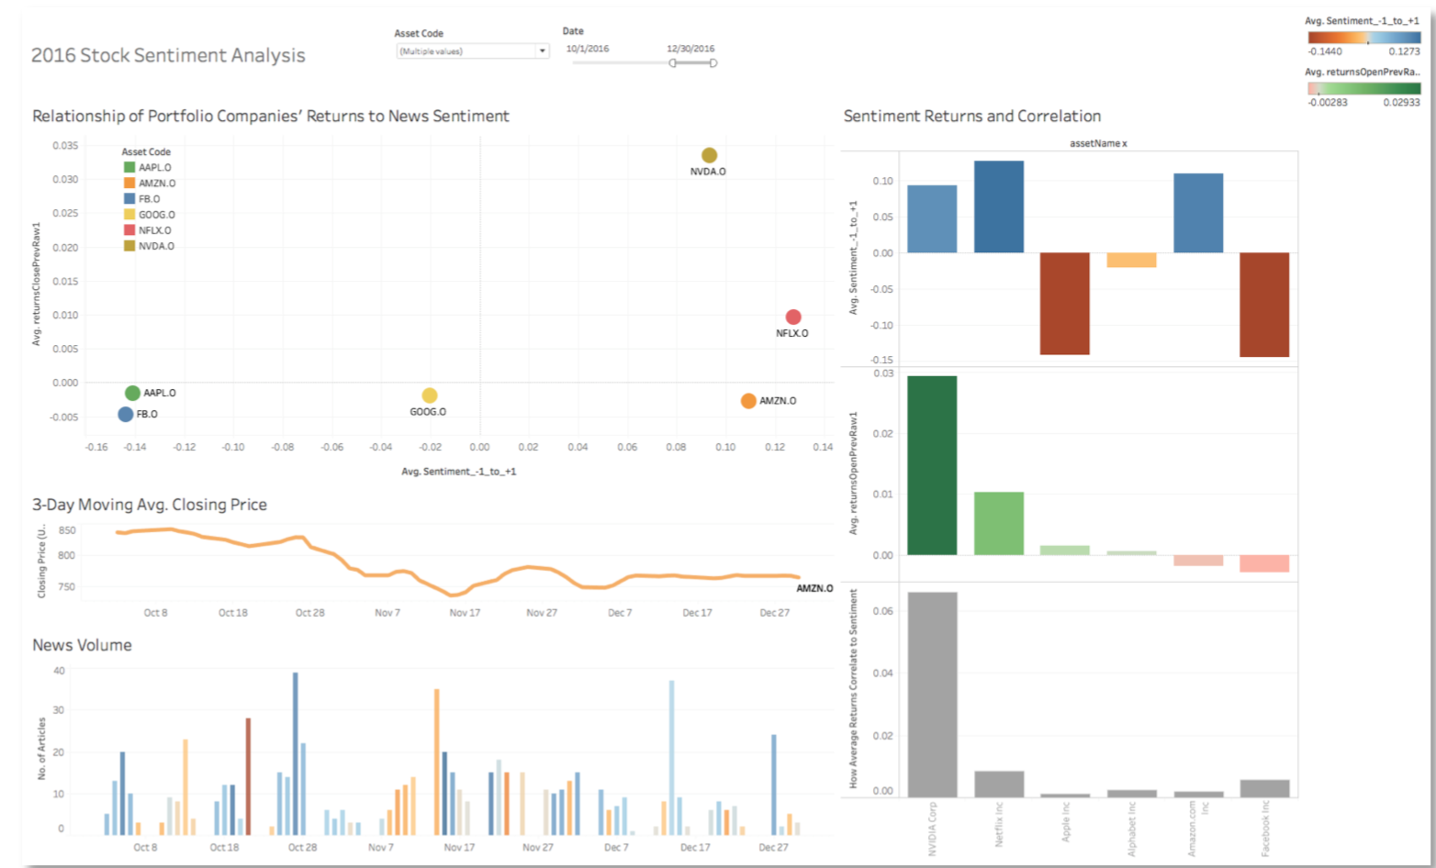
Usability Testing Prototype

Slide 5
User Feedback & Integrations
Must Do
Observation | Recommendation
Low discoverability of asset code & date filter | Create clear title and location for filtering.
Unable to recall ticker names of companies | Replace ticker names of companies with company names, keeping referencing elsewhere as data labels
Users did not understand use of color for sentiment | Provide a scale legend to correlate color with news sentiment. Place near news sentiment visual.
Users unable to glean insightful information from all graphics on right side of tool | Improve annotation of graphs. Re-organize and re-scope graphs to provide insightful information on mins and max’s.
Users could not read nor understand labels | Simplify variable names in labels. Provide additional information to variable source
Misalignment with previous mental model -- users did not find value 3-day moving average | Change 3-day moving average to daily closing price

Slide 6
User Feedback & Integrations
Should Do
Observation | Recommendation
No call to action -- users did not know how to interact with visualization | Add instructions to visual to guide user on steps.
Users did not know what the “.O” and “.N” suffixes were to the ticker symbols | Replace ticker names of companies with company names, keeping referencing elsewhere as data labels
Users did not know what news volume was composed of | Provide a description of data and what news volume is composed of

Slide 7
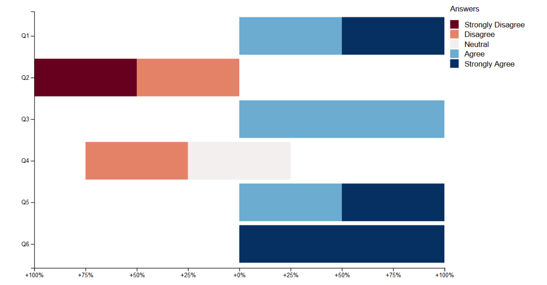
Likert Scale Response
Q1. The charts were helpful in gaining insights of what companies are mostly and least affected by news sentiment.
Q2. The chart labels are easy to understand.
Q3. The chart axes are easy to understand.
Q4. There is appropriate use of chart types in the visualization
Q5. The use of colors is clear and helpful.
Q6. The tasks/activities during this exercise wer easy to execute and meaningful.

Slide 8
Final Product...

Slide 9
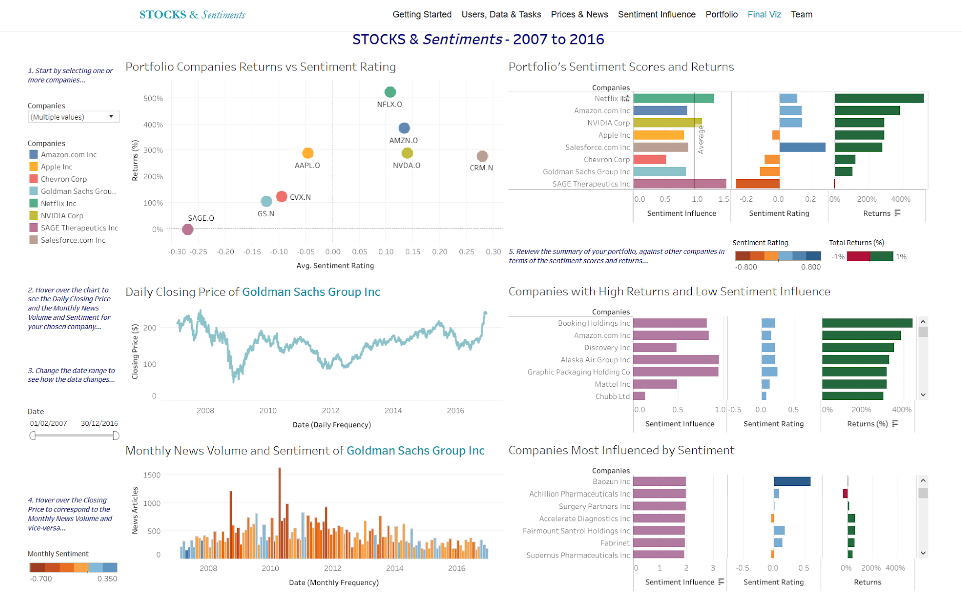

Slide 10

Use Cases
Watching the News
You are watching CNN and they mention some negative news about a company that you’ve invested in. Could this impact the stock? Do you sell?
Investment Peace of Mind
You want to invest in a company without worrying about every headline that pops up on YahooNews. Which companies can let you have a good night’s sleep, despite the noise?
Portfolio for the future
You are a looking to create or revamp your portfolio from scratch with a long-term horizon, but want to diversify. Where do you start?

Slide 11

Insights
Delay in Response
When applicable, closing price is not always immediately reactive to volume or sentiment of news. Often there is a couple day delay that results in a drop.
The Ups and Downs and Inbetweens
News sentiment for a single stock can fluctuate greatly over time. Having a vast time frame does not always provide fruitful data.
The bigger they are… the larger they stay the same
FAANG companies remain unyielding to positive and negative news.
++
+++

Slide 12
Tools
Python
Data Processing
Tableau
Data Visualization
JS/HTML5/CSS/Bootstrap
Building the UI

Slide 13

The Team
Ava Rezvani
ava.rezvani@berkeley.edu
Kuangwei Huang
kuangwei@berkeley.edu
Christina Papadimitriou
c.papadimitriou@berkeley.edu

Slide 14

Workload
Distribution
 | AR | CP | KH
Project Idea
Project Proposal
Prototype Design
Usability Testing
Usability Changes
Coding
Graphic Design
Final Presentation
Video Demo

Slide 15

DEMO TIME!
http://people.ischool.berkeley.edu/~c.papadimitriou/stocksAndSentiment/

